Slide 1
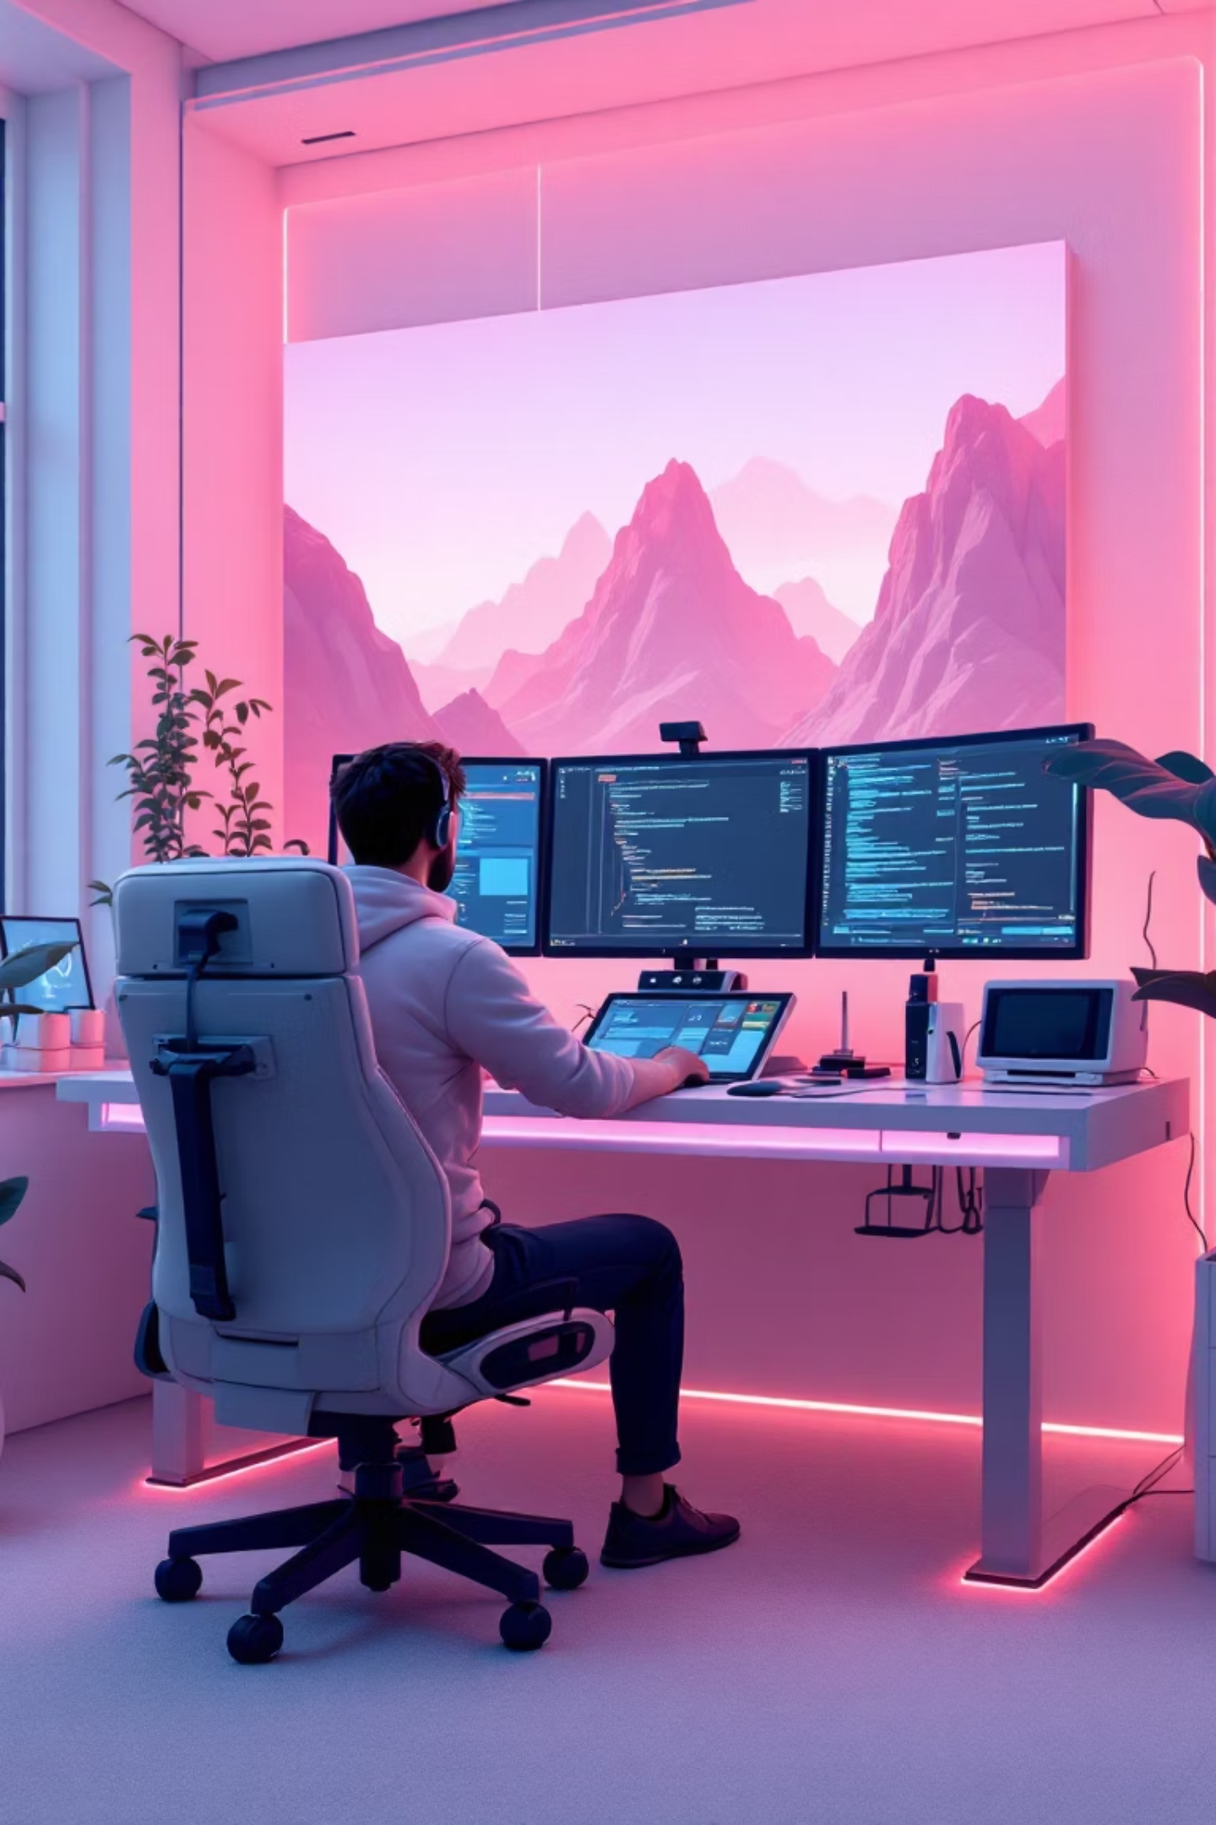

Daydream Game Jam
D.A.V Public School ATL Lab
September 27th, 2025 • 7 AM - 7 PM
Organized by Navi Raj

Slide 2

About Daydream Hack Club
Daydream is a worldwide teen-led Game Jam powered by Hack Club, bringing together creative minds across the globe.
This fall, 100+ cities will host simultaneous game jams, creating an unprecedented wave of teenage innovation and creativity.
Whether you're a coding wizard or have never touched a game engine, this event welcomes all high school and upper-middle school students ready to dive into game development.

Slide 3




Why Join the Revolution?
Master Game Development
Create & Share
Learn Godot engine through hands-on workshops and expert mentorship
Build a game you're genuinely proud of and showcase it on itch.io
Connect & Grow
100% Free Experience
Meet like-minded creators, explore new skills, and expand your creative horizons
Everything included: meals, learning materials, and supportive environment

Slide 4

Game Rules & Technical Guidelines
1
Godot Engine Only
2
Submit on itch.io
All games must be developed using the Godot game engine - no exceptions
Your final creation must be uploaded and playable on the itch.io platform
3
Original or Free Assets
4
Start After Theme Reveal
Use self-created content or royalty-free resources - respect intellectual property
No pre-development allowed - creativity begins when the theme drops

Slide 5
Judging & Epic Rewards
Judging Criteria
1st
2nd
Creativity & Originality - How unique is your vision?
Gameplay & Fun Factor - Does it captivate players?
Raspberry Pi 4B
Arduino Mega
Theme Coherence - How well does it match the theme?
Ultimate maker's prize
Advanced development board
Polish & Presentation - Is it ready to impress?
Evaluation by organizers and peer teams
3rd
Arduino Uno
Perfect starter kit
Plus: Certificates & digital badges for all participants!

Slide 6
Your 12-Hour Journey
7:00-7:30 AM • Launch Sequence
1
Registration, badges, and energizing breakfast to fuel your creativity
2
7:30-8:00 AM • Mission Brief
Epic theme reveal and comprehensive rules briefing
8:00 AM-12:30 PM • Code Sprint 1
3
Intensive development session - bring your ideas to life
4
12:30-1:00 PM • Refuel Break
Nutritious lunch to recharge your mind and body
1:00-4:30 PM • Code Sprint 2
5
Continued development plus mid-jam progress check-in
6
4:30-5:00 PM • Power-Up
Snacks and exciting mini-challenge activities
5:00-6:30 PM • Final Push
7
Polish your masterpiece and submit to itch.io
8
6:30-7:00 PM • Victory Showcase
Present your games and celebrate with prize distribution

Slide 7




We've Got You Covered
Premium Venue
Pro Equipment
State-of-the-art ATL Lab with high-speed Wi-Fi, reliable power, and comfortable workstations designed for innovation
Smart board and professional microphone system for theme reveals and game showcases
Emergency Support
Full Catering
Power banks, extra charging cables, and technical backup supplies for seamless development
Morning snacks, hearty lunch, evening treats - we fuel your creativity all day long

Slide 8
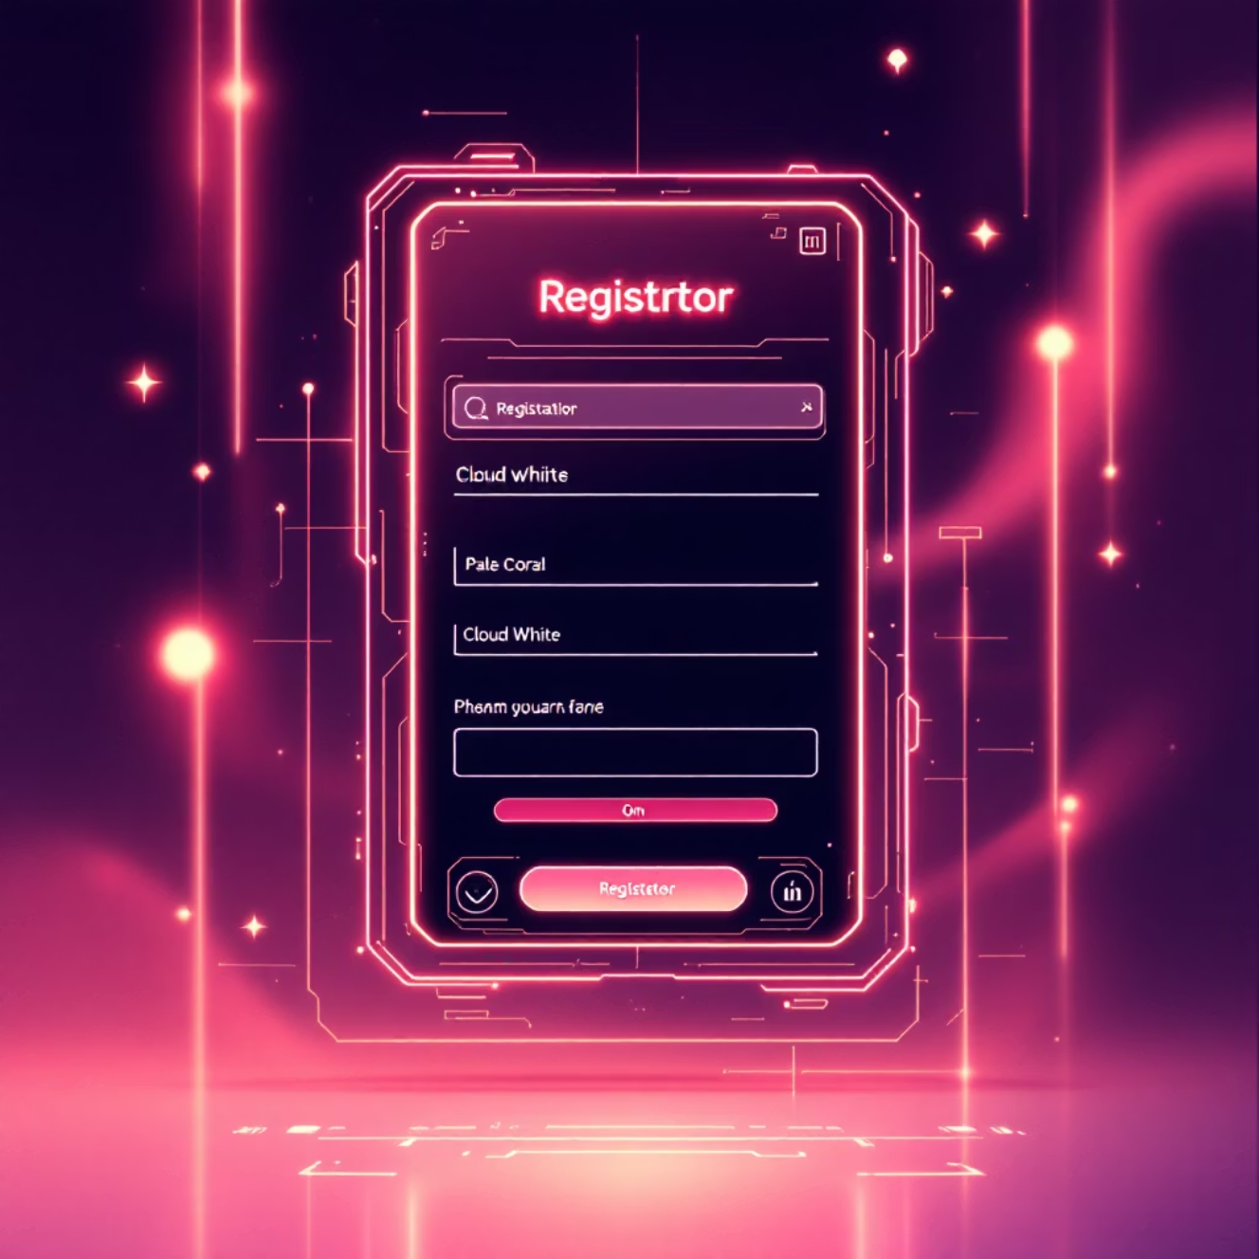
Ready to Join the Adventure?
01
Register Online
Complete the Daydream setup form before the deadline
02
Gear Up
Bring your laptop, charger, and any personal development tools
03
Arrive Early
Be at the ATL Lab by 7:00 AM sharp - punctuality is key!
04
Come Ready
Open mind, willingness to learn, and excitement to create

Slide 9

Dream Big
Build Brave
Share Proud

Slide 10
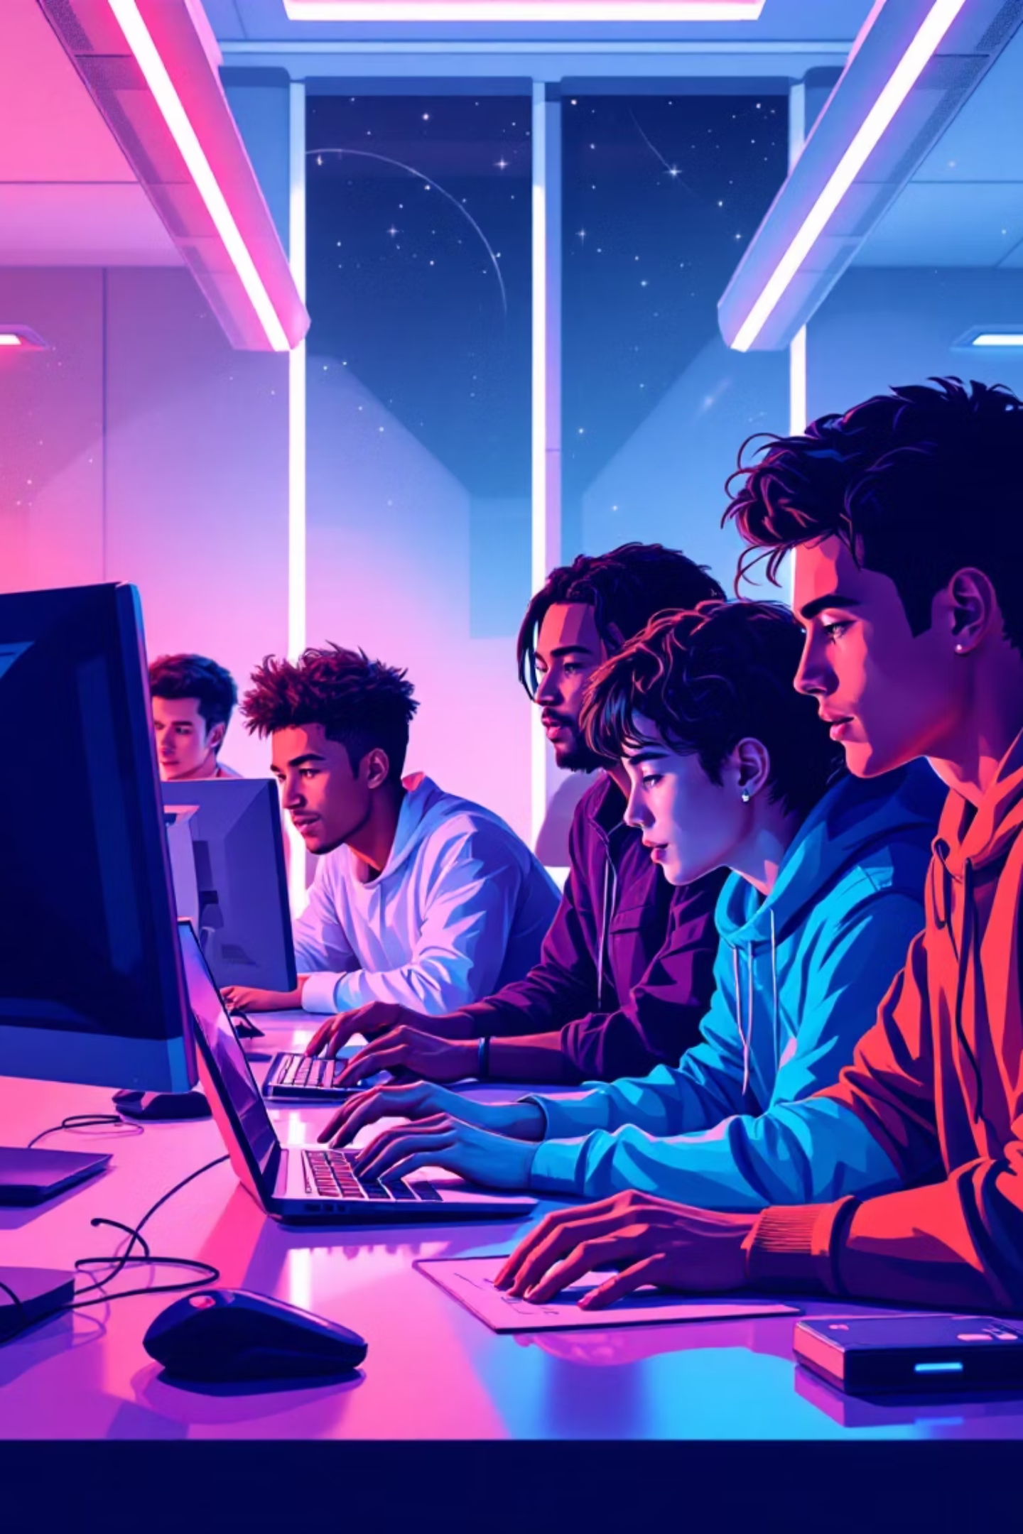
Your Moment Awaits
This is your chance to create something extraordinary with Godot and our incredible school community. Together, we'll push the boundaries of what's possible.
Let's show the world what we can build when we code with passion, create with purpose, and dream without limits!
See you at the ATL Lab - the future of gaming starts with you.

